Slide 1

Health Data Analysis
By: Sreepriya Meerel

Slide 2
Business Understanding:
The dataset used in analysis is related to a healthcare organization.
It consists of information specifically related to patient’s appointment booking and other patient details such as age, gender, medical conditions, etc.
It also contains data related to scholarship programs and reminder services offered by organization.

Slide 3
Project Overview:
Exploratory Data Analysis (EDA) was performed to extract valuable insights, and to draw conclusions about the reasons for patients not showing up for appointments. .
Future actions are recommended to address the issue of patients not showing up for appointments and make continuous improvements to clinical workflow process.

Slide 4

Understanding the data

Slide 5
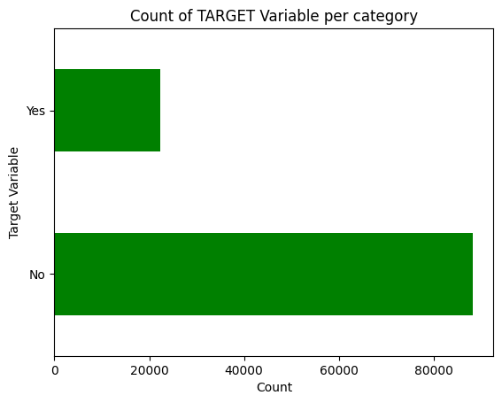
Target Variable:
In this EDA, “No show” was considered as target variable.
Data was found to be highly imbalanced, with a ratio of 80:20.
To understand target variable in more depth, both univariate and bivariate analysis was performed to get some useful insights about reasons behind missed appointments, so as to help the healthcare organization to plan adequate future actions.

Slide 6
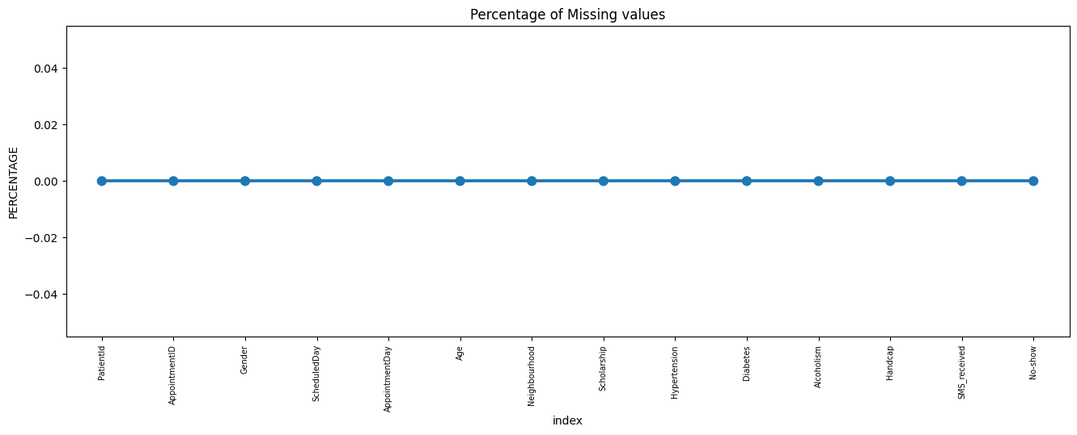
Missing Data: No missing values were found in the dataset

Slide 7
Data Cleaning:
Some columns such as ‘Patient Id’, ‘Appointment Id’, ‘Scheduled Day’, ‘Appointment Day,’ which have no impact on analysis were deleted.
Bins were created for the column ‘Age’ for the ease of analysis and a new column name ‘Age group’ was created by grouping the data in bins of 1-17 years following which ‘ Age ‘ column was removed .
By creating bins for ‘Age’ patient data could be easily identified for children and adults during analysis.

Slide 8
Univariate Analysis

Slide 9
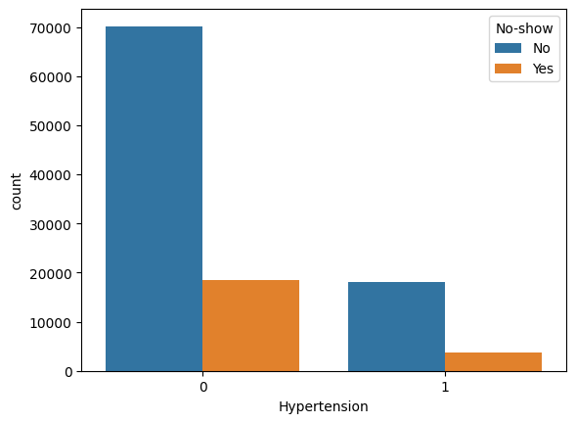
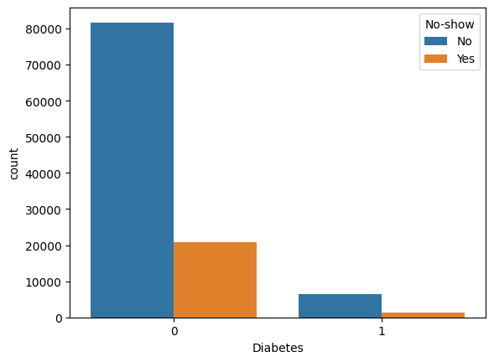
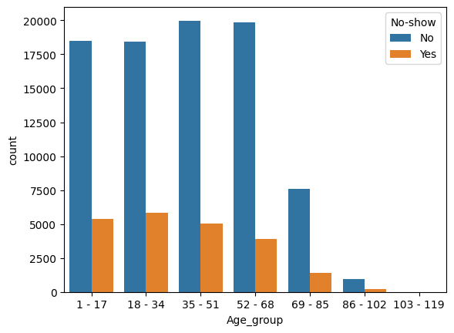
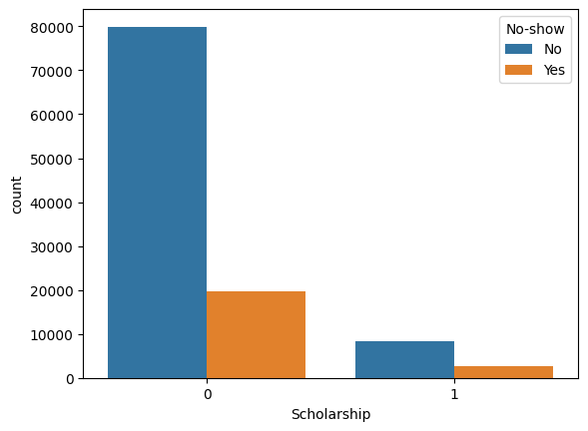
Findings:
No show %
Hypertension-17.30%
Without hypertension-21%
No show %
Diabetes-18%
Without Diabetes-20.36%
Higher no-show ups seen in 18 - 34 (years): 24%
Patients above 52 and below 103 are most likely to show up for appointments.
Churn rate among people receiving Reminder SMS:27.57%

Slide 10
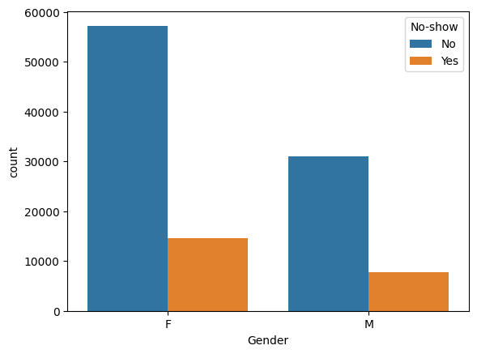
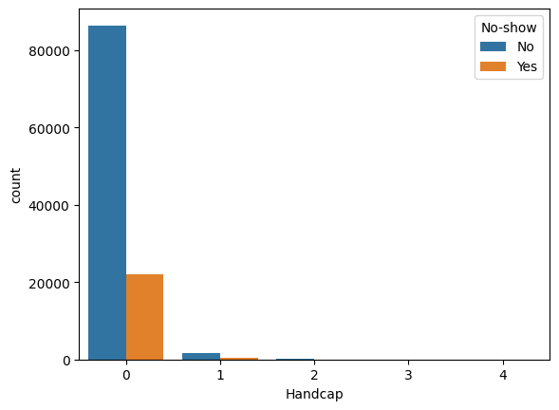
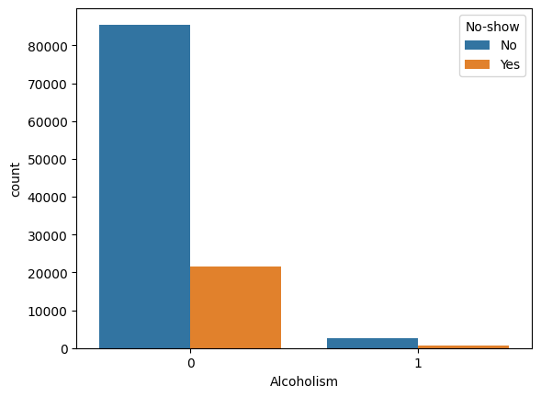
Findings:
Gender, Alcoholism and Disability does not seem to have significant impact in univariate analysis.

Slide 11
Univariate Analysis Findings:
Gender does not seem to have significant impact as both males and females show equal tendency to miss appointments.
No show up is higher for patients enrolled in scholarship program.
Patients without hypertension more likely to miss appointments.
Patients without Diabetes more likely to not show up during appointments.
Alcoholism seem to have no impact on missing appointments as patients who are alcoholic have similar churn rate compared to non alcoholics.
In case of disability, level 1 and 2 disability seem to have no impact on missing appointments while the like hood of not showing up for the appointment increases when handicapped level is 3 or more .
People receiving SMS reminders show a higher tendency to miss appointments.
Chances of no show up is higher in children, young adults and patients above the age of 109 years
Patients above 52 and below 103 are least likely to miss appointments.

Slide 12

Bivariate Analysis

Slide 13
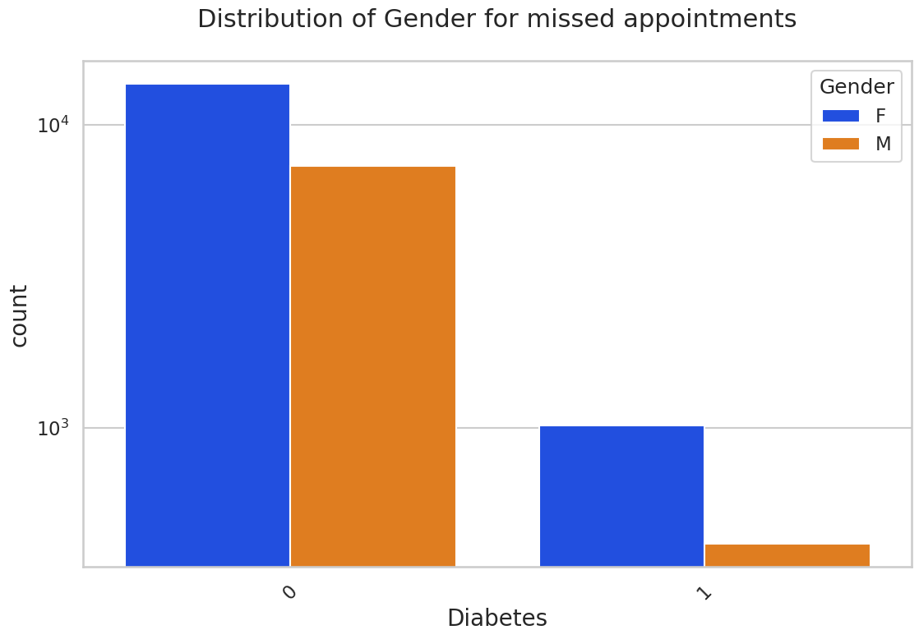
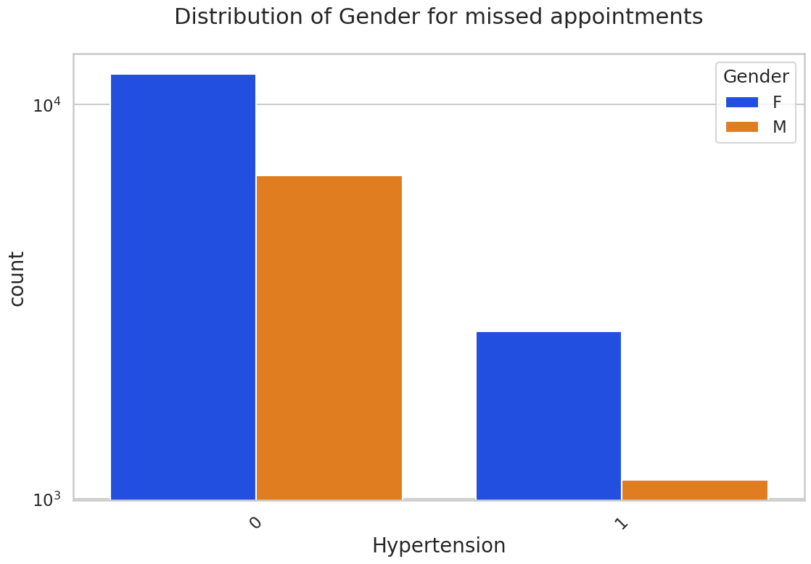
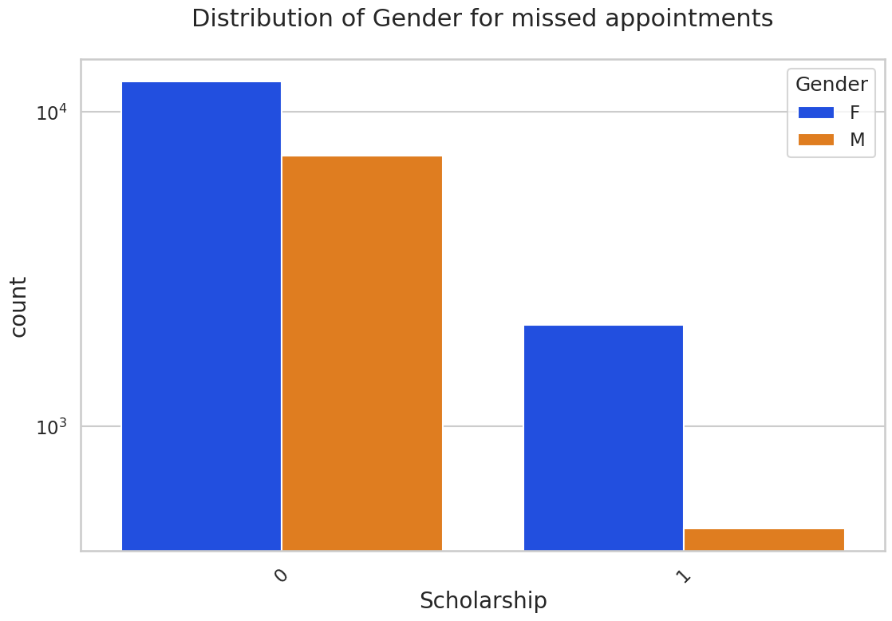
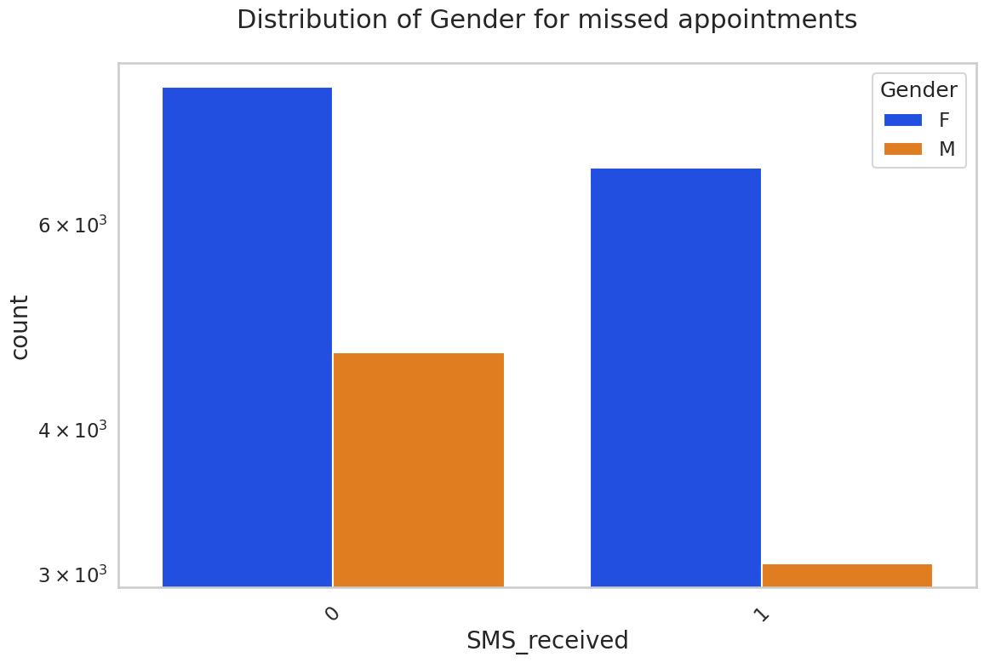
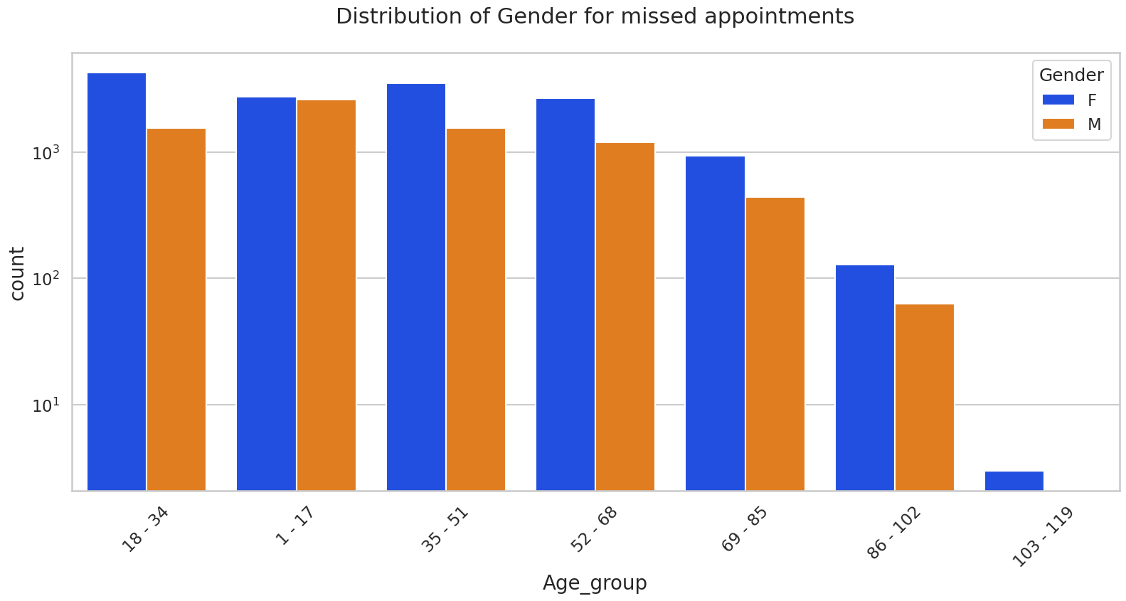
Findings:
Females are more likely to miss appointments.

Slide 14
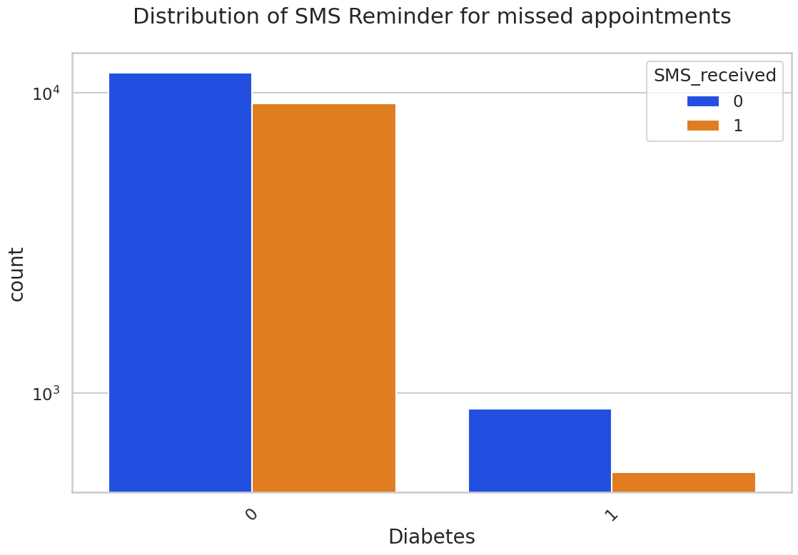
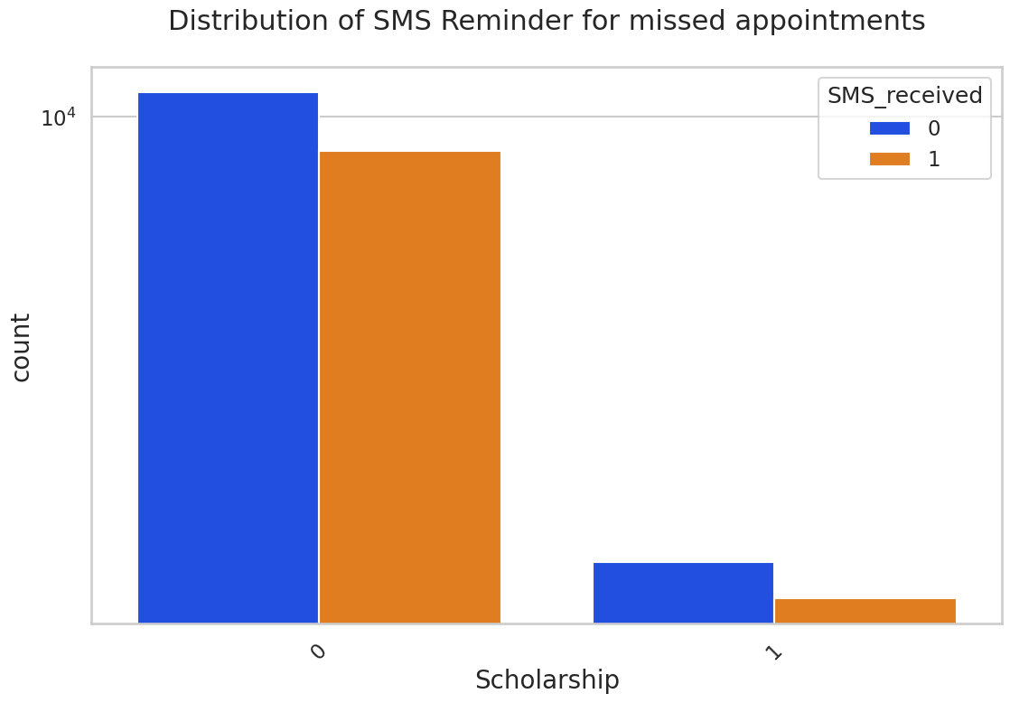
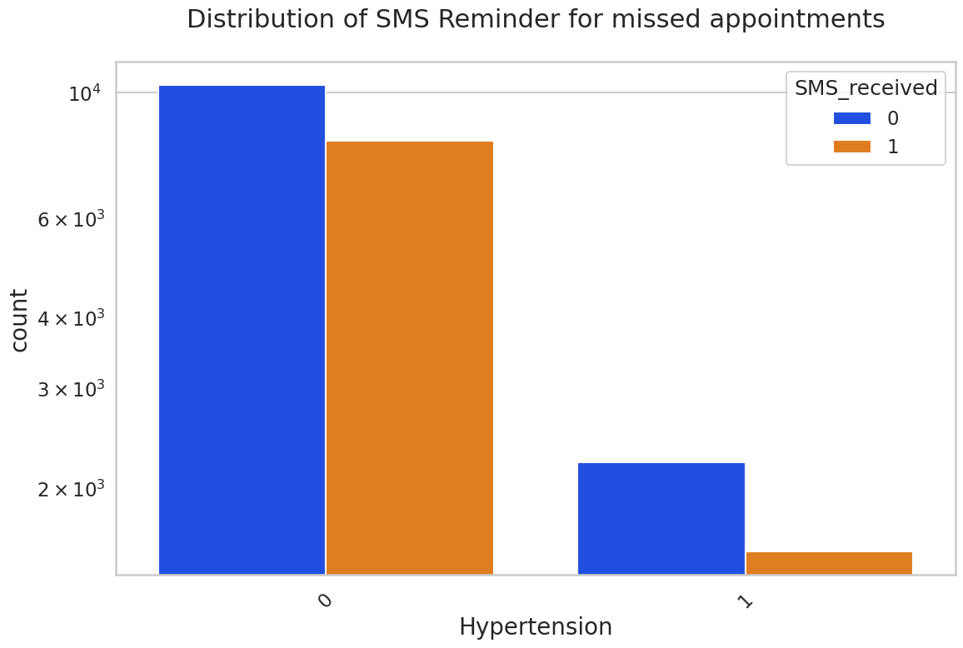
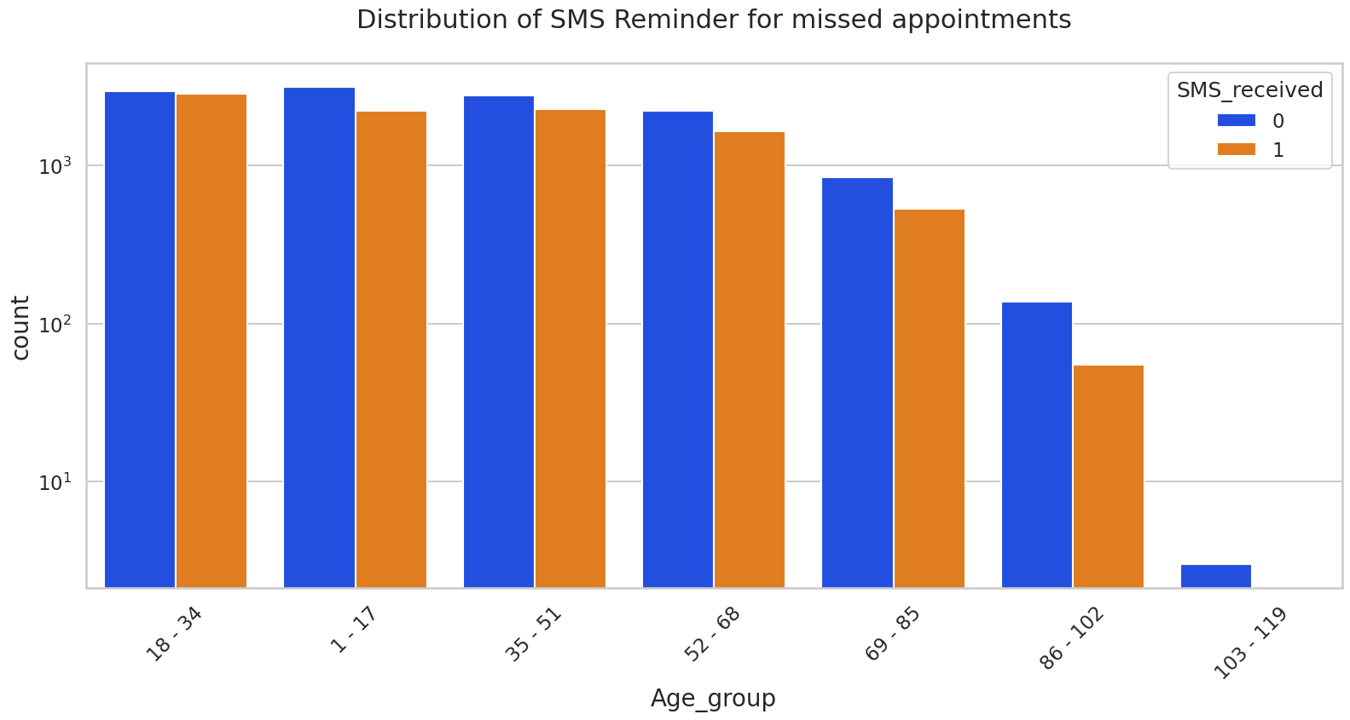
Findings:
Patients not receiving SMS reminders are more likely to miss appointment.
A significant proportion of patients are not receiving reminders.

Slide 15
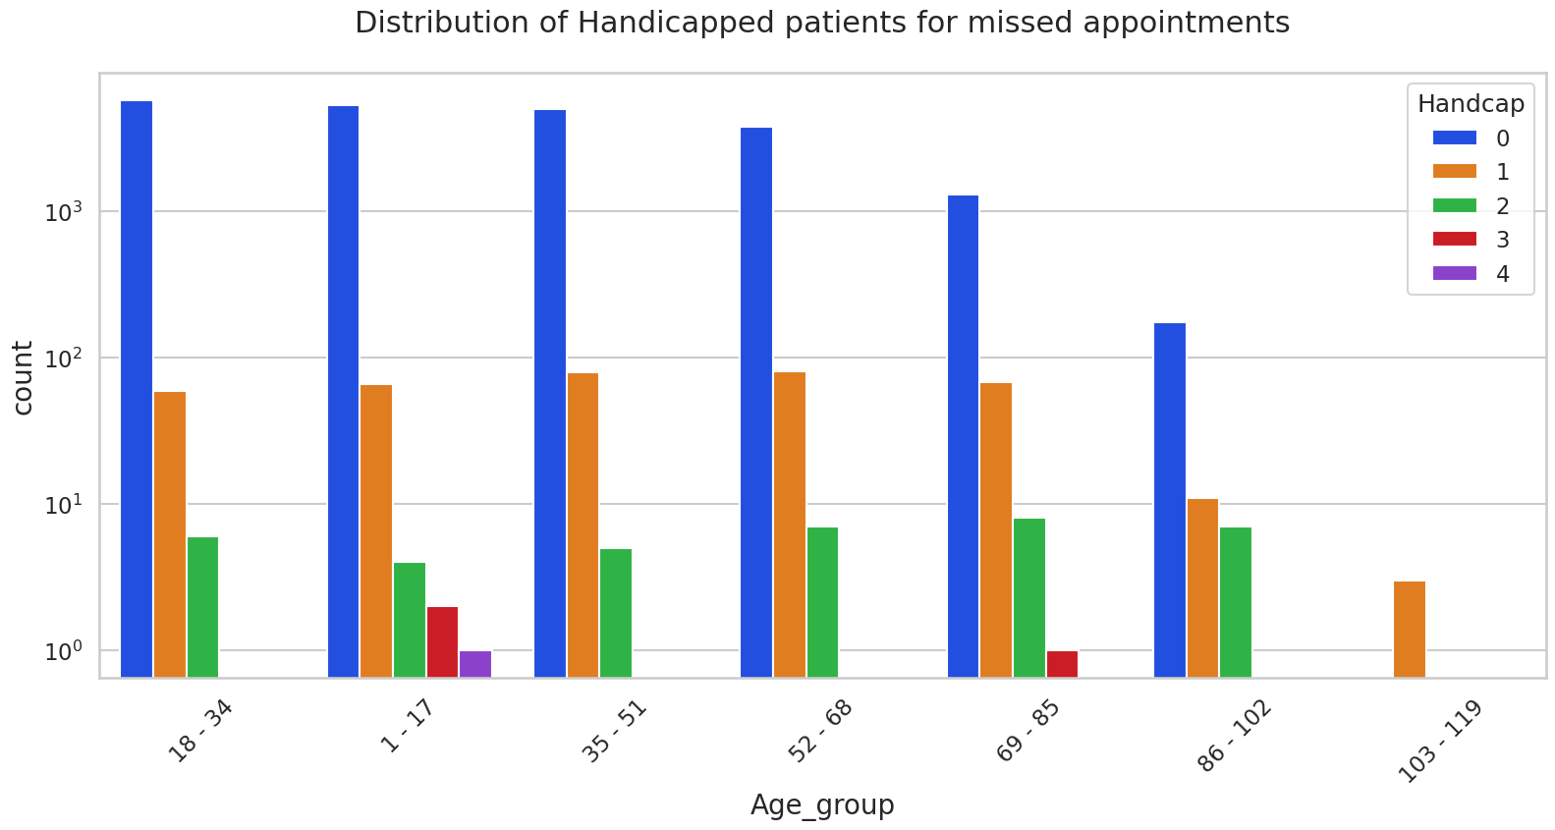
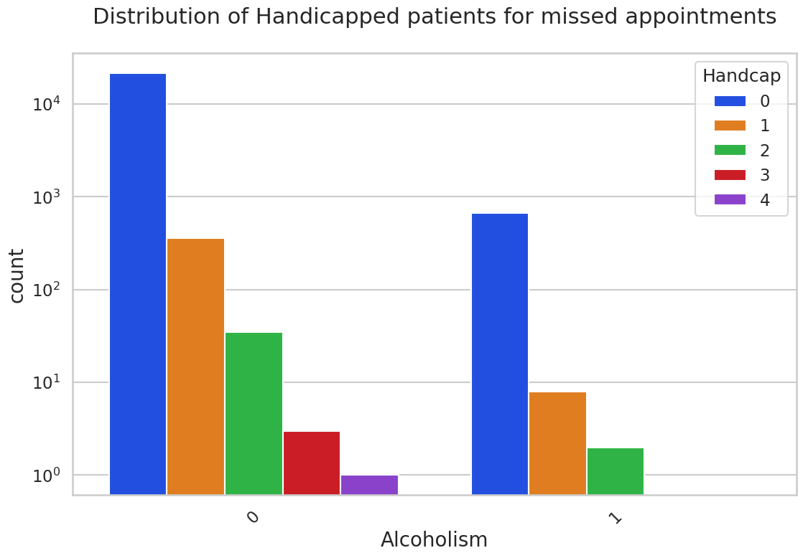
Findings:
Severely handicapped patients are not alcoholic.
Disability level- 3 is more prevalent in Pediatric(1-17) and older age(69-85) groups.

Slide 16
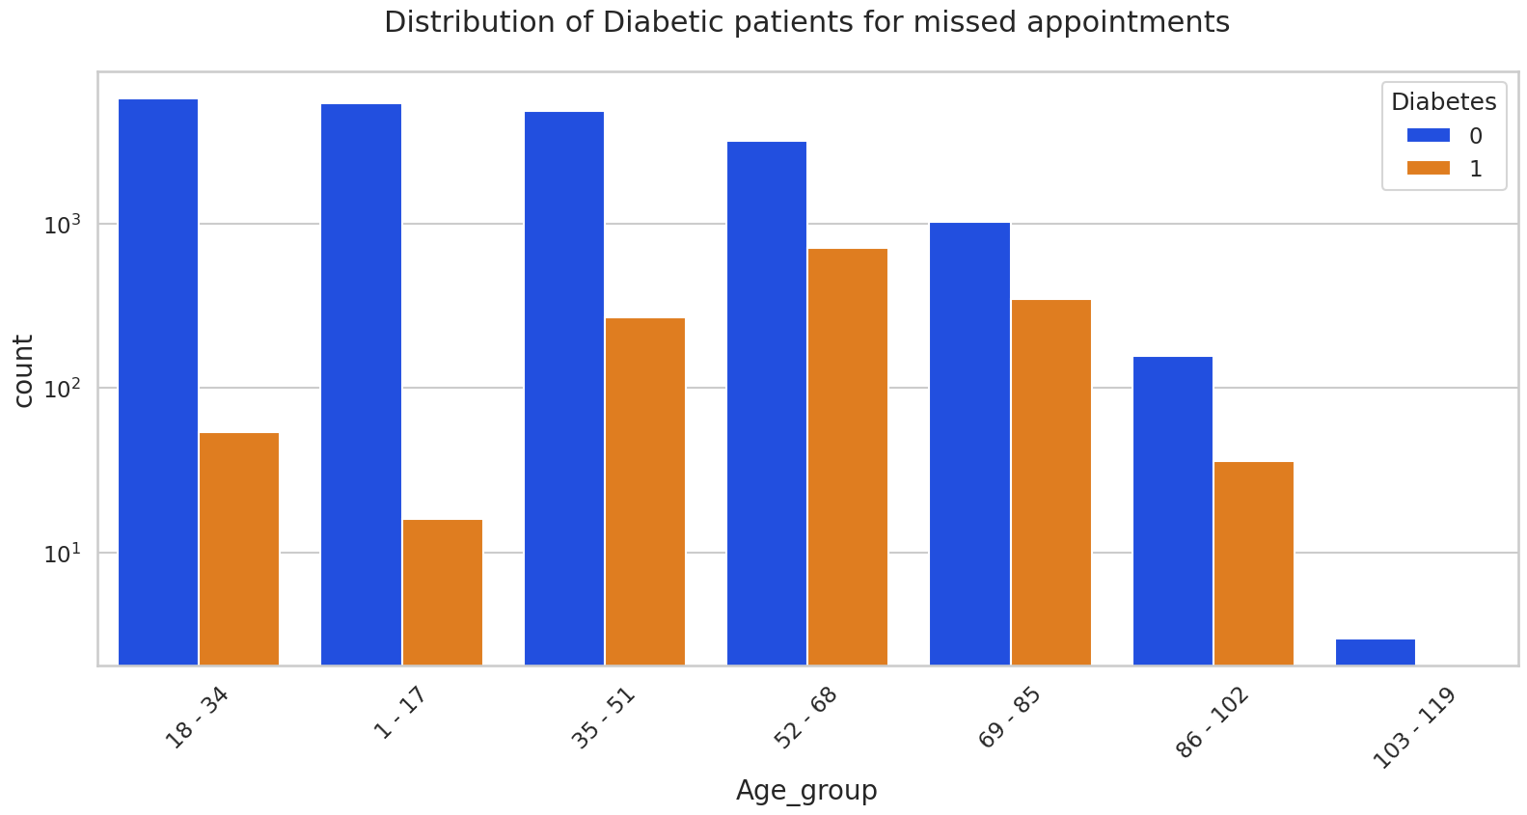
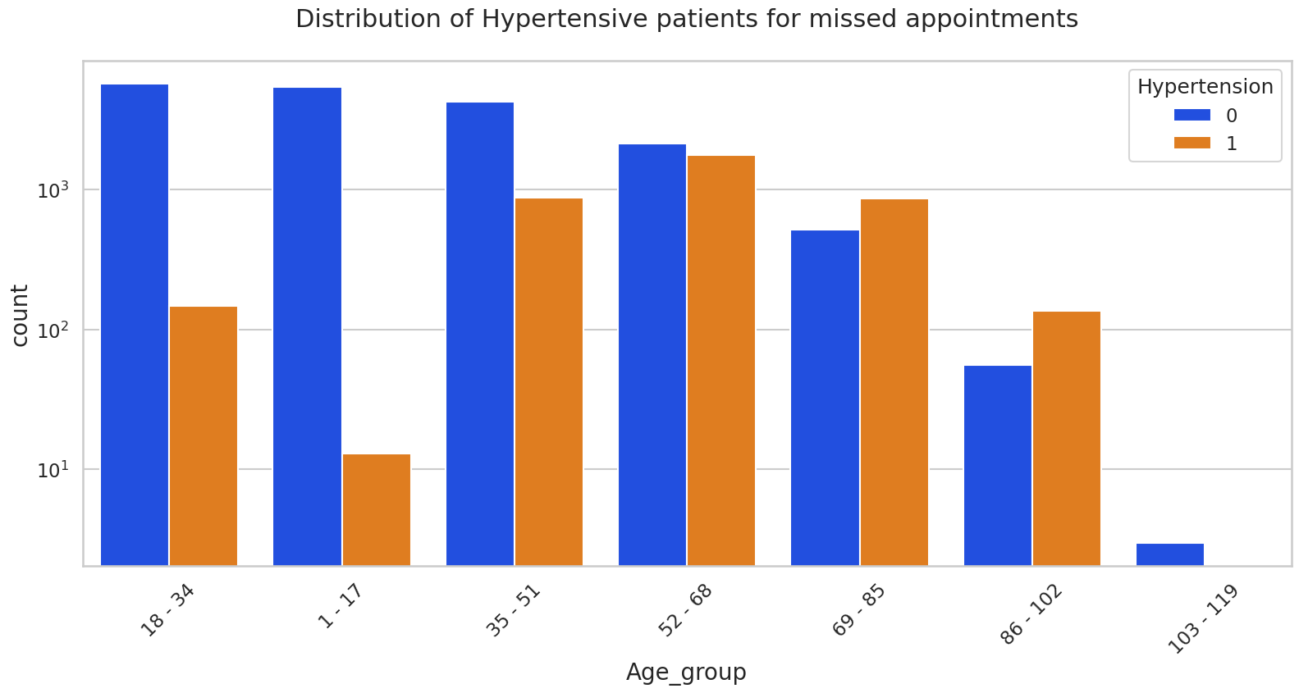
Findings:
Patients above 35 years of age are more prone to *hypertension* and *Diabetes* and as age advance beyond 55 there is sharp increase in patients with these conditions.
In most of the cases diabetes and hypertension are coexisting.

Slide 17
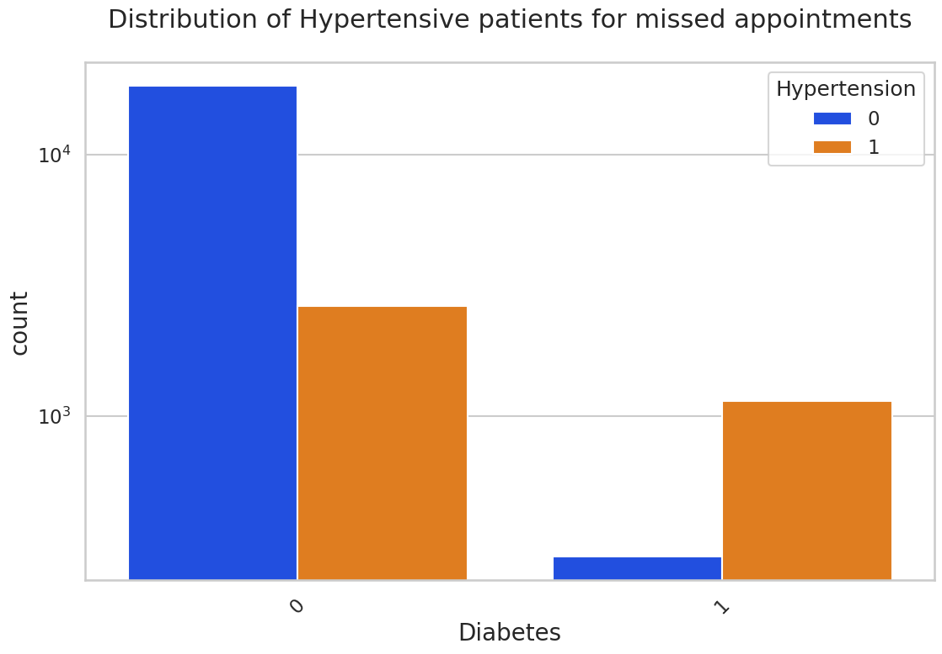
Findings:
Most of the diabetes patients have coexisting hypertension and show an increased tendency towards not showing up for appointment.

Slide 18
Bivariate Analysis Findings:
Females on scholarship programs, with hypertension and or with diabetes are more likely to miss appointments.
Females are more likely to no show up even after receiving appointment reminder SMS.
Overall females seem to miss appointments more in all age groups.
Males consuming alcohol have slightly higher chances of not showing up for appointments.
Disability seem to have not much impact on missing appointment based on gender and since patients with severe disability are very few in numbers so role of gender is not clear in that case.
A higher percentage of patients on scholarship are not receiving SMS reminder and have higher chances of not showing up.
Most of the patients who do not have hypertension are not receiving SMS reminder. Even in case of hypertensive patients, majority of them are not receiving SMS reminder.
Higher number of patients with diabetes are not receiving SMS reminder.
Chances of receiving SMS reminders are very less in Alcoholic, Handicapped , Pediatric and very old patients.
Disability level- 3 is more prevalent in Pediatric(1-17) and older age(69-85) groups. These age groups are not receiving SMS reminders too.
Severely handicapped patients are not alcoholic.
A higher proportion of Diabetic patient have hypertension as well and are more likely to miss appointments.
Patients above 37 years of age are more prone to hypertension and Diabetes and as age advance beyond 55 there is sharp increase in patients with these conditions and in most of the cases diabetes and hypertension are coexisting.
Cases of Diabetes and Hypertension is very low in children.

Slide 19
Conclusion:
Higher Appointment missing rate are seen due to :
Ineffectiveness of the SMS reminder service :
A significant portion of patients do not receive SMS reminders regardless of their medical condition and disability status and end up missing appointments.
Although a good proportion of young adults receive SMS reminders but a relatively low prevalence of chronic conditions such as Diabetes and Hypertension among this age group, makes them more prone to missing appointments.
Pediatric and very elderly patients are more likely to miss appointments due to lack of SMS reminders for their appointments and also,
SMS reminders are not active for patients with disability level 3 or more . Level 3 disability is frequently associated with pediatric (1-17) and older age(69-85) groups which may contribute further to no show up.
Patients enrolled in scholarship programs also face challenges with SMS reminders, as a higher percentage of them do not receive them.
Gender's Role: Females, across all age groups, exhibit a higher propensity to miss their appointments, even when they have:
Chronic medical conditions.
Enrollment in scholarship programs.
Received SMS reminders.

Slide 20
Conclusion(Cont’d):
No impact-
Alcoholism does not have significant affect on no show up.
Among alcoholic patients, males are least likely to receive SMS notifications , therefore a slight increase in no show ups are evident among them.
Lower Appointment missing rate (Regular Patients):
Seniors
A significant majority (75%) of patients who consistently attend their appointments are above the age of 50.
Presence of health issues
Conditions like Hypertension and Diabetes are more prevalent among seniors, making patients in the age group of 50-100 years less likely to miss appointments as they need active medical attention and follow-ups.

Slide 21
Recommended Actions:
Strengthening
Strengthening the reminder system: Set up automated appointment reminders through SMS, email, or phone calls to reduce forgetfulness or scheduling conflicts for all the patients.
Scheduling
Streamline scheduling: Ensure that the appointment scheduling process is efficient and accommodating to patient needs, possibly offering flexible hours or online booking.
Assess
Assess socioeconomic factors: Investigate if there are financial or social barriers preventing patients from attending appointments and develop strategies to address them.
Develop
Targeted outreach: Develop outreach programs for high-risk demographics or areas with a higher no-show rate such as Females and Severely Handicapped patients.
Educate
Patient education: Educate patients about the importance of their appointments (especially to young adults and females)and the impact of no-shows on the healthcare system.
Create
Feedback system: Create a system for patients to provide feedback on their experiences and use this to continuously improve clinic operations.

Slide 22
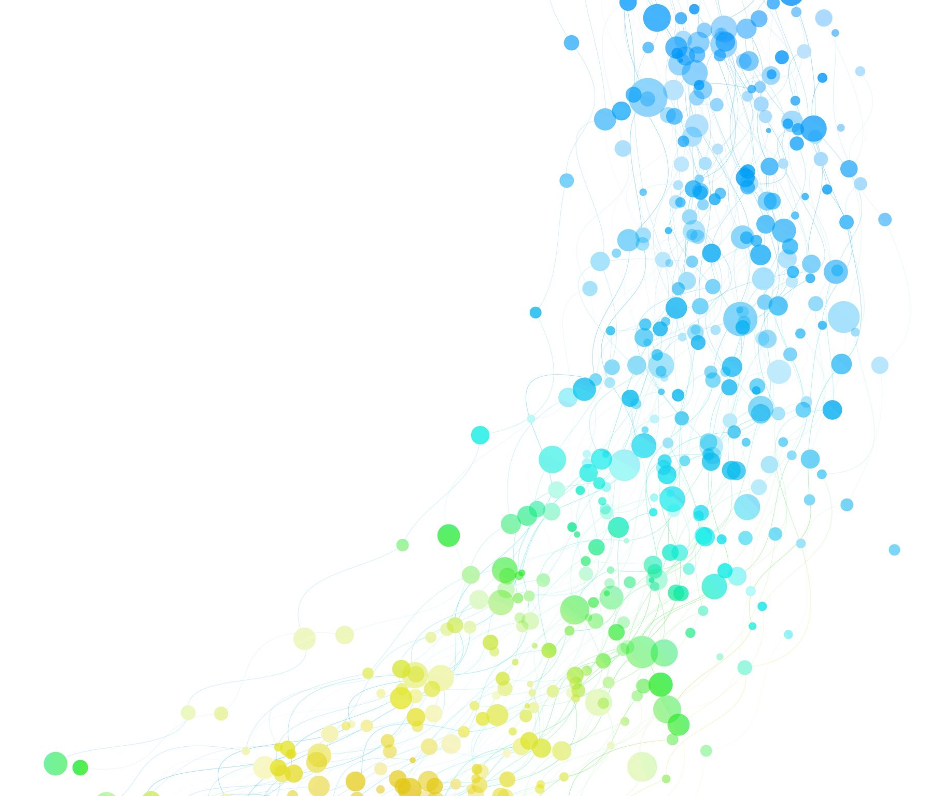
Thank you

